Slide 1

CSE6224 SOFTWARE REQUIREMENT ENGINEERING
CAMPUS EVENT CHECK-IN SYSTEM (CECS)
Group 4
1. Eric Teoh Wei Xiang (1221102007)
2. Pang Tian You (1231303394)
3. Siow Yi Ling (1211107982)
4. Lim Kai Shen (1211110602)
PRESENTATION VIDEO LINK (YOUTUBE)
HTTPS://YOUTU.BE/ZUO9LAHGLMQ

Slide 2

Introduction
Overview
Manual event check-ins are slow and error-prone.
Our system uses QR codes for fast, digital check-ins.
Students register easily via mobile.
Admins manage events and track attendance in real time.

Slide 3
TASK 1
Vision:
Mobile-first platform for seamless event management.
Features: QR check-in, payment integration, real-time tracking, feedback collection.
Scope:
Mobile-only system for students (registration, payments, check-in) and admins (event management, analytics).
Goals:
Digitize event lifecycle, reduce administrative burden, enhance student engagement.

Slide 4
TASK 2
Material Context Objects:
Students, Admins, Authentication/Payment Servers, QR Codes, Events, Notifications.
Immaterial Context Objects:
Processes (Login, Payment, Refund, Check-in, Feedback).
Requirements Sources:
Stakeholders: Students, Admins, University IT, Finance Dept.
External: Payment gateways (FPX/TNG), Reference systems (Eventbrite).

Slide 5
TASK 3
Prototyping:
Wireframes → High-fidelity mockups → Stakeholder feedback → Final refinement
Student/Users:
Login page
Event list page
Register event page
Payment page
Rating & Feedback page
Scan QR Code page
Admin:
Login page
Create and manage event page
View refund page
View payment page
View rating page
Attendance report page

Slide 6
TASK 3
Questionnaire:
Estimate minimum of 25 responses from students and 5 responses from administrators
Kano Categories:
Dissatisfiers (Must-Have): Login, QR check-in, payment processing.
Satisfiers (Performance): Refund handling, real-time notifications.
Delighters (Excitement): Event rewards, calendar sync, heatmaps.

Slide 7
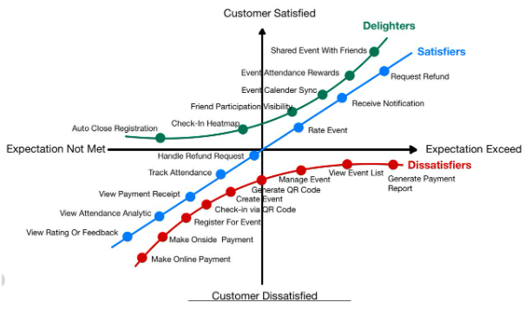
TASK 3
Kano Model (Plan)

Slide 8
TASK 4
📋 44 Responses (31 Students, 13 Admins)
✅ Kano Categorization
Must-Haves: Registration, QR Check-In, Payment
Satisfiers: Refunds, Ratings, Notifications
Delighters: Calendar Sync， Friend Participation， Event Sharing， Attendance Rewards
🧩 Prototype (Figma)
→ Complete Flow: Student & Admin
💬 Feedback
✔️ Smooth system, clear UI
🎯 Suggestions: Add Calendar Sync, Friend Visibility, Sharing, Badges

Slide 9
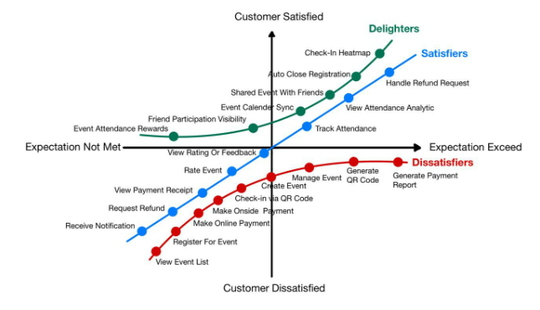
TASK 4
Kano Model For Requirements Categorization Summary

Slide 10

Requirements
System Overview
Diagram
System Context
Diagram
Use Case Diagram
Class Diagram
ERD Diagram

Slide 11
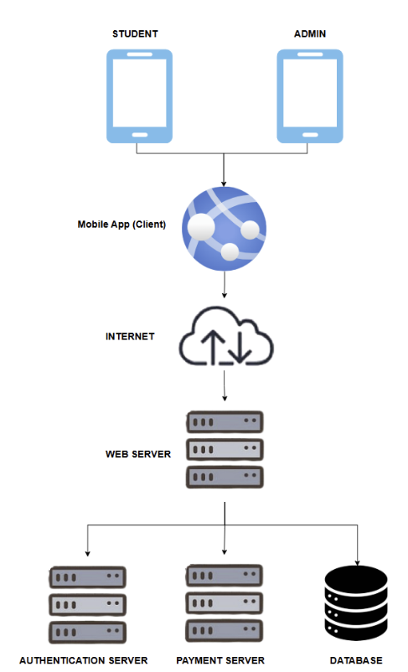
System Overview Diagram
Campus Event Check-In System

Slide 12
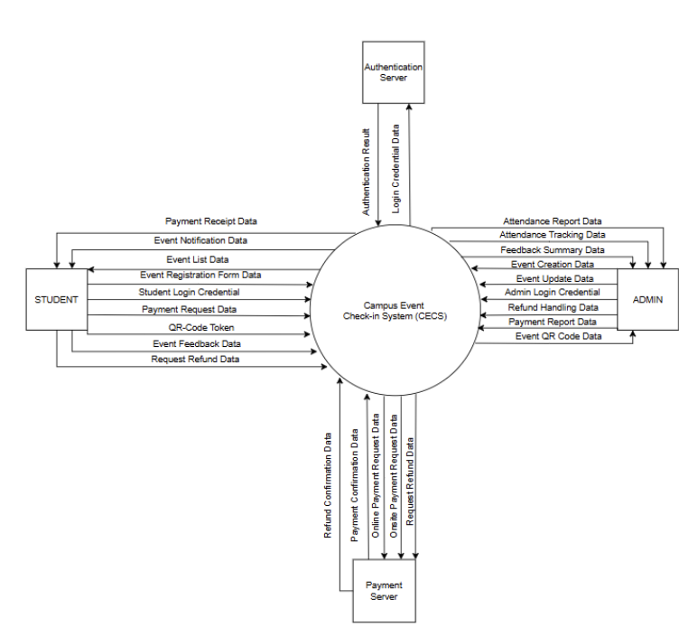
System Context Diagram
Campus Event Check-In System

Slide 13
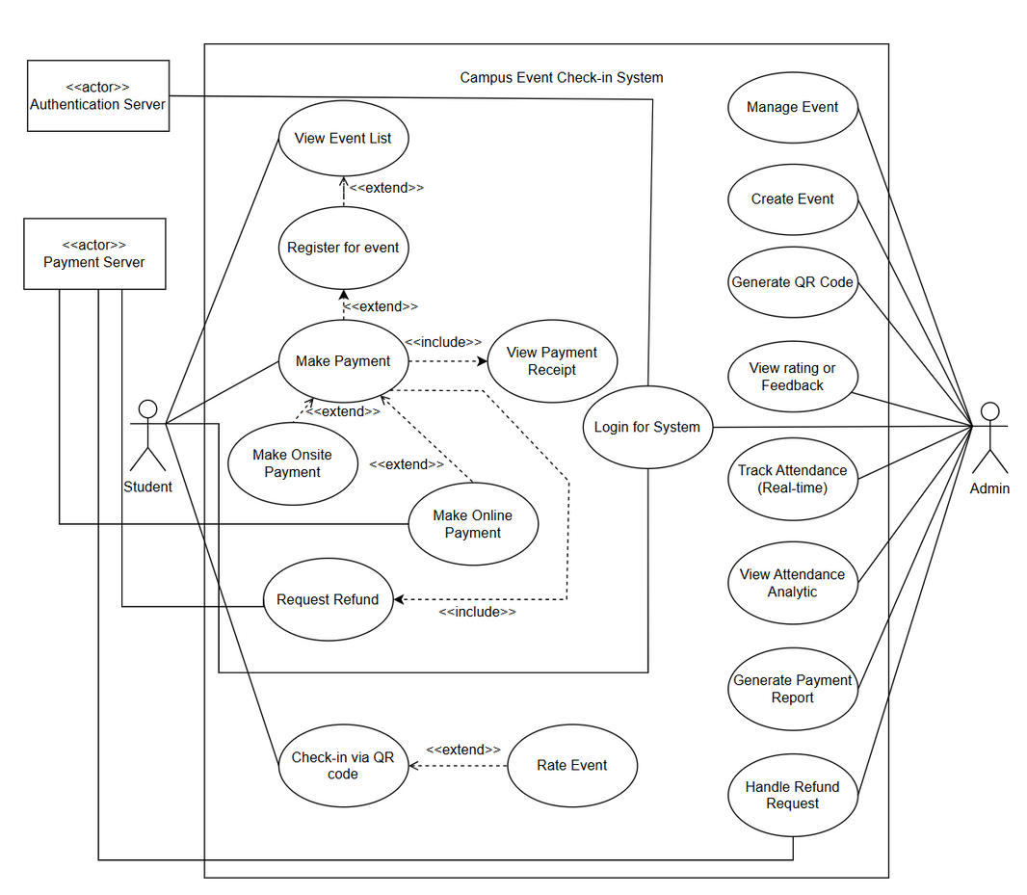
Use Case Diagram
Campus Event Check-In System

Slide 14
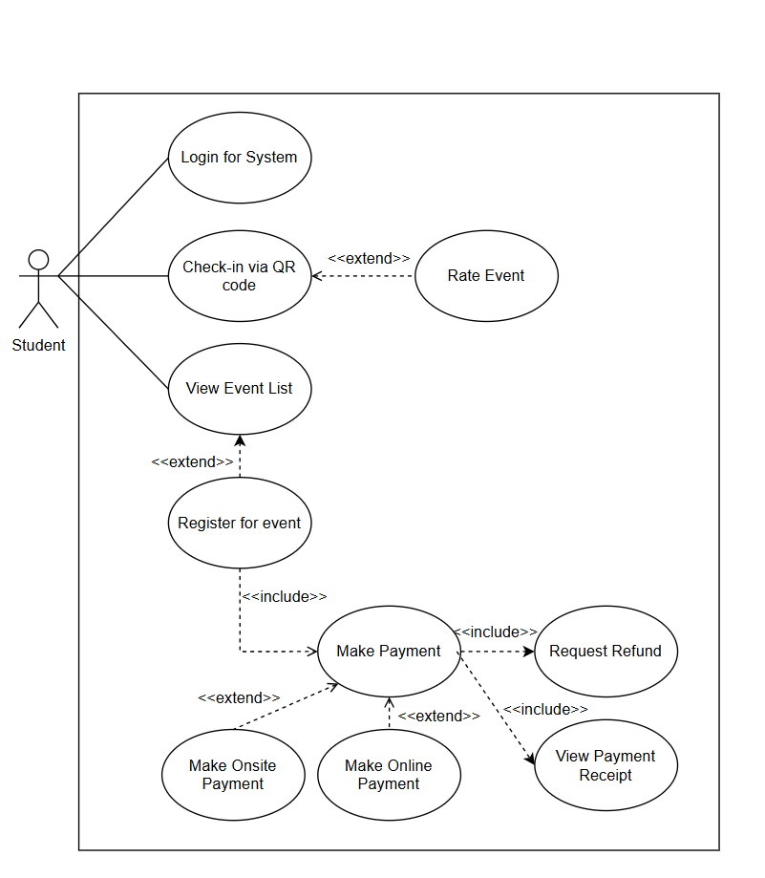
Use Case Diagram
Student

Slide 15
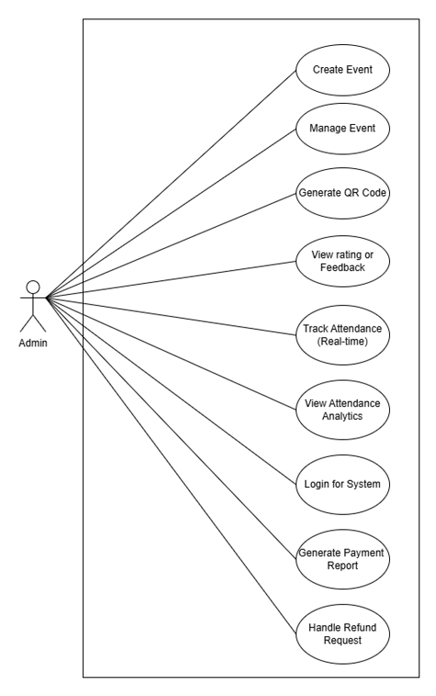
Use Case Diagram
Admin

Slide 16
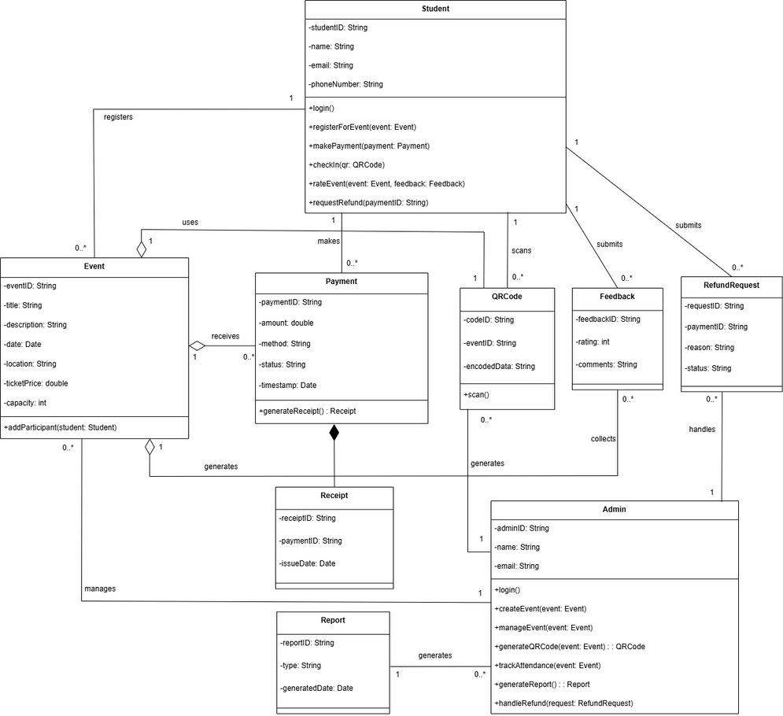
Class Diagram

Slide 17
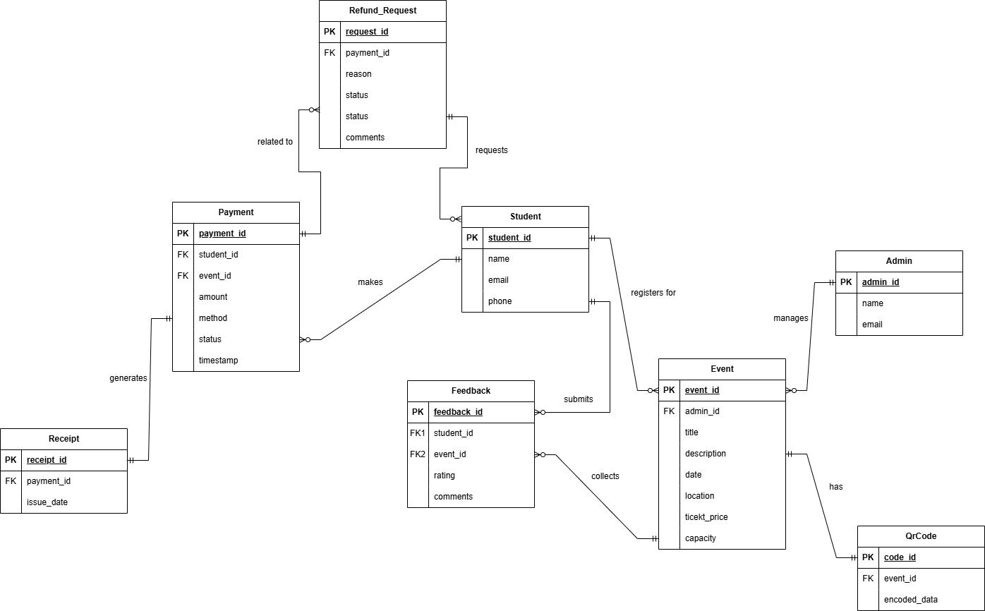
Entity Relationship Diagram

Slide 18
Prototyping

Slide 19
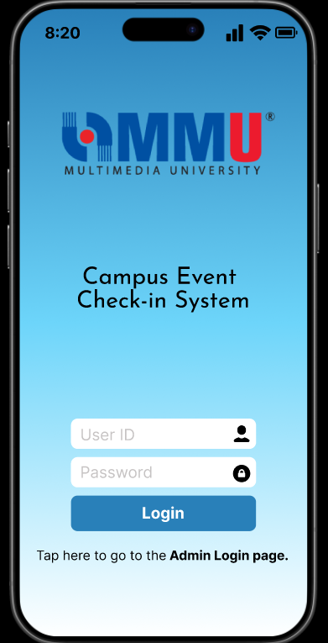
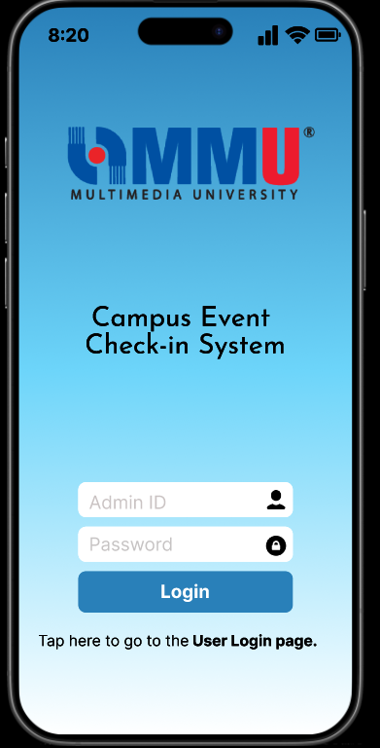
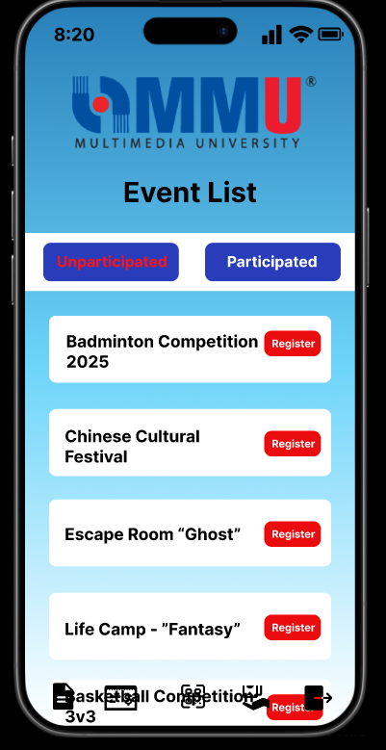
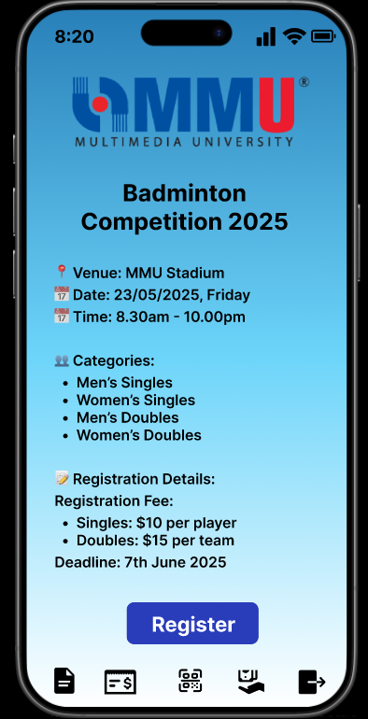
Prototyping
Login Page (User)
Login Page (Admin)
Unparticipated
Event List Page (User)
Event Details Page (User)

Slide 20
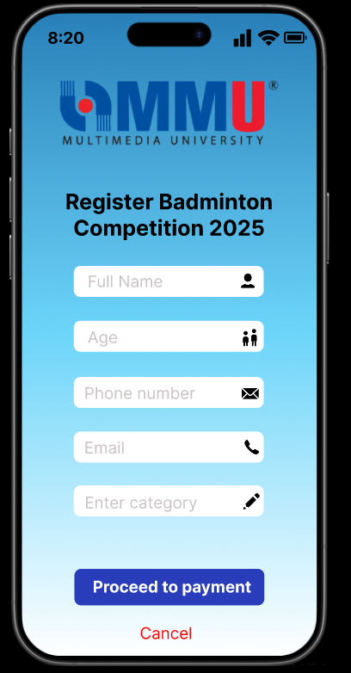
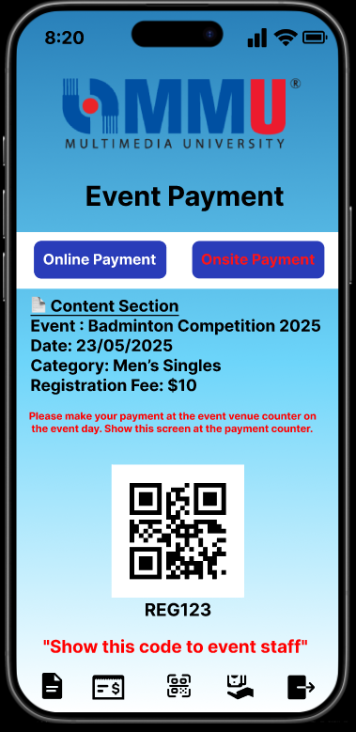
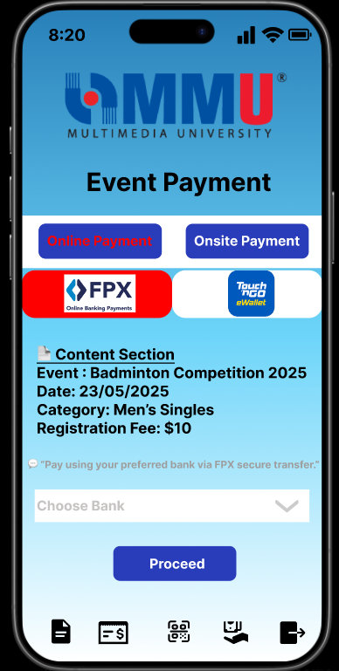
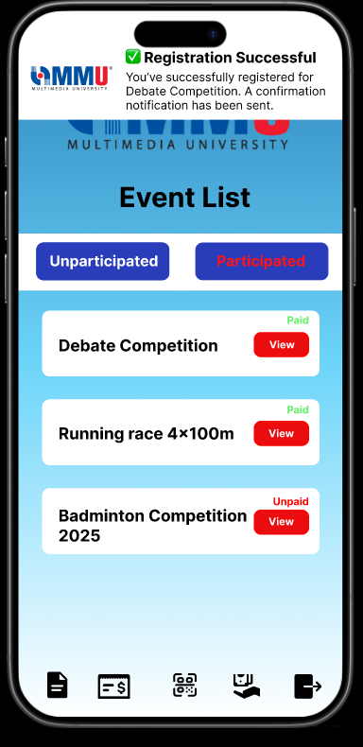
Prototyping
Register Event Page (User)
Event Onsite Payment
Page (User)
Event Online Payment Page (User)

Slide 21
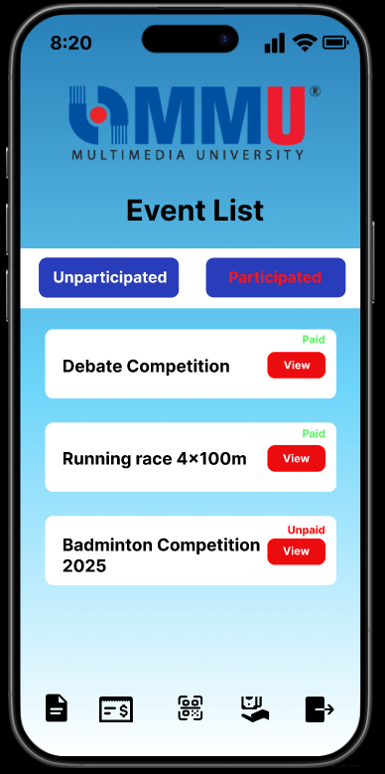
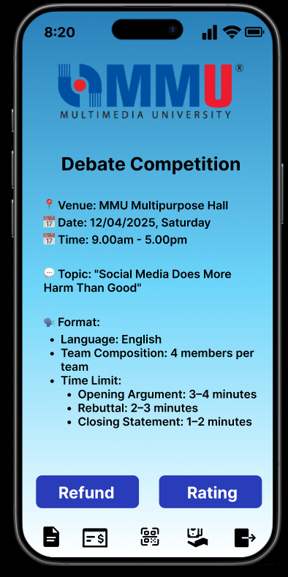
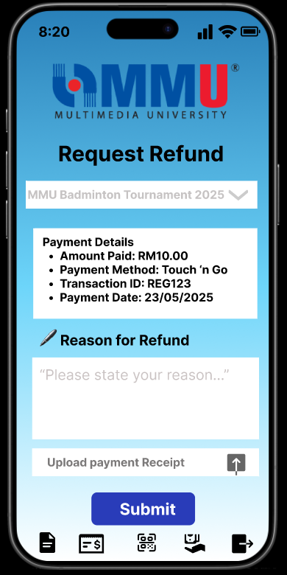
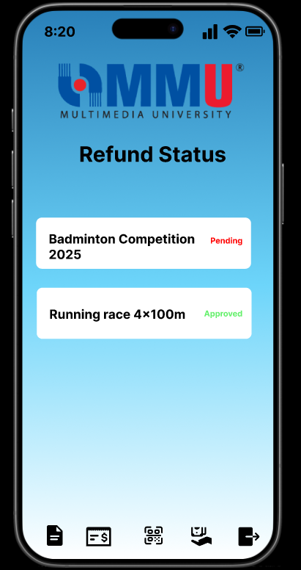
Prototyping
Participated Event
List Page (User)
Participated Event
Description Page (User)
Request Refund Page (User)
Refund Status Page (User)

Slide 22
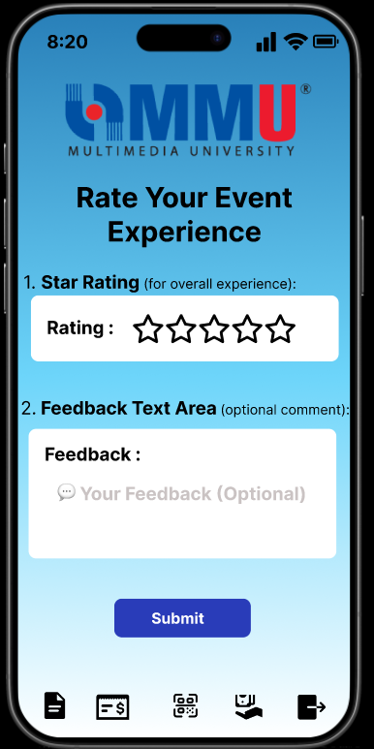
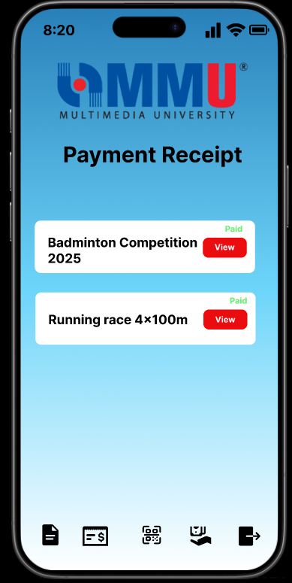
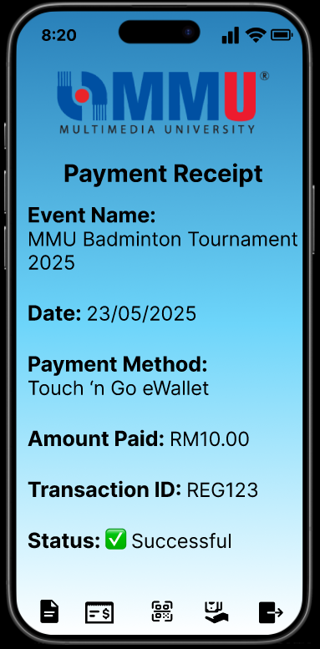
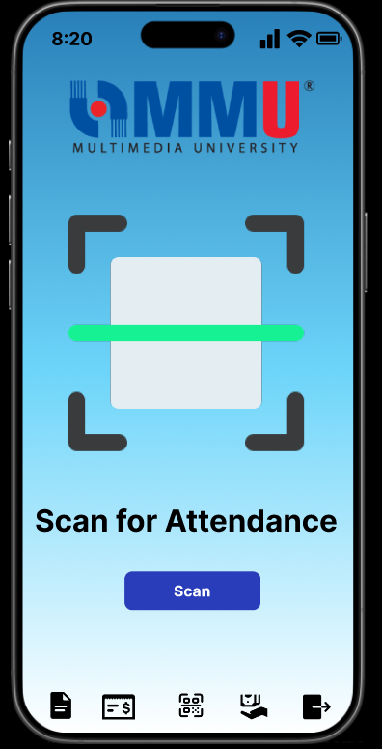
Prototyping
Rating Page (User)
Payment Receipt Page (User)
Scan Attendance Page (User)

Slide 23
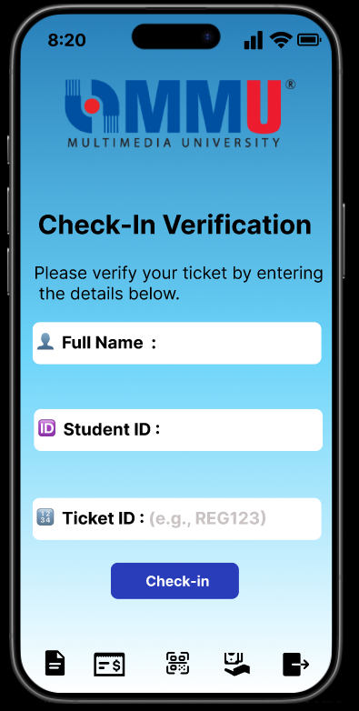
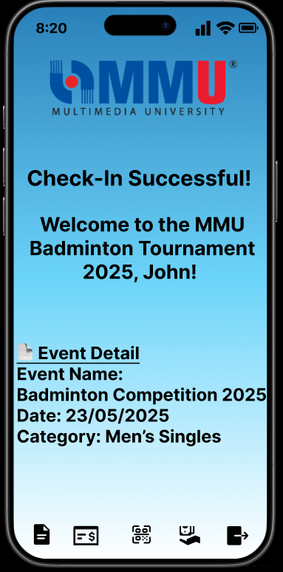
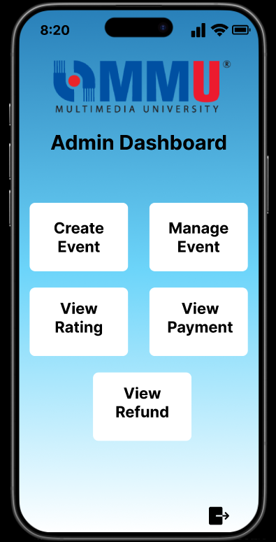
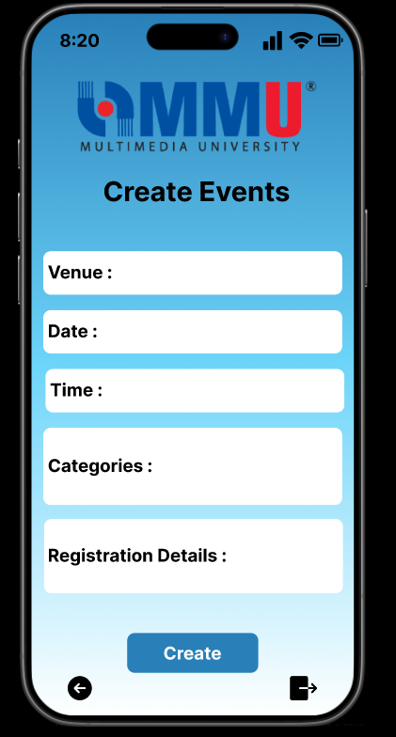
Prototyping
Verification Page (User)
Dashboard Page (Admin)
Create Event Page (Admin)

Slide 24
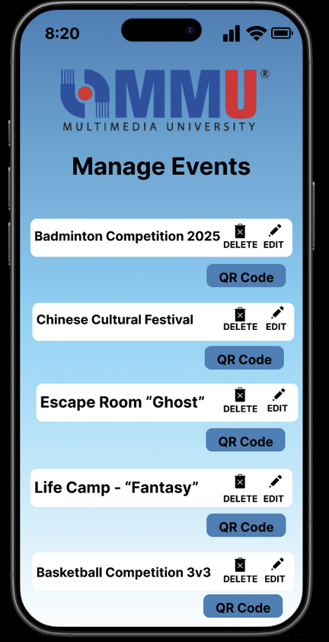
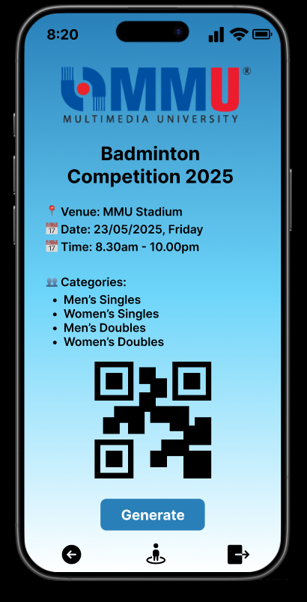
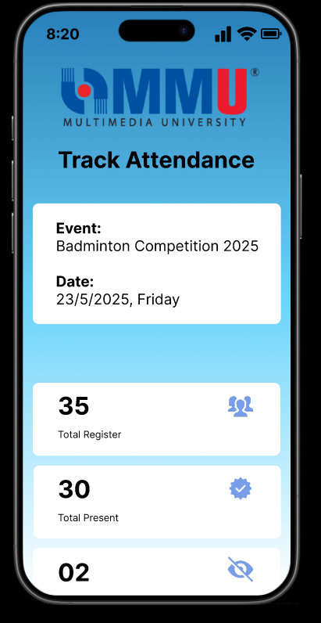
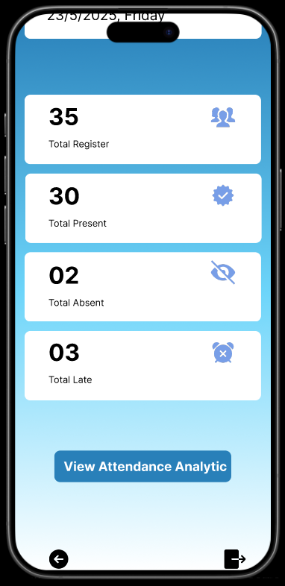
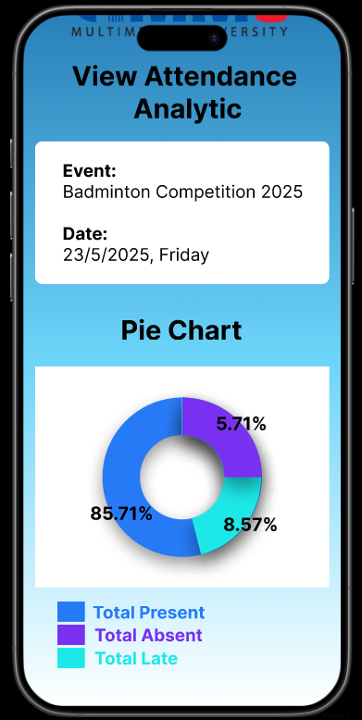
Prototyping
Manage Page (Admin)
Event QR Code Page (Admin)
Track Attendance Page (Admin)

Slide 25
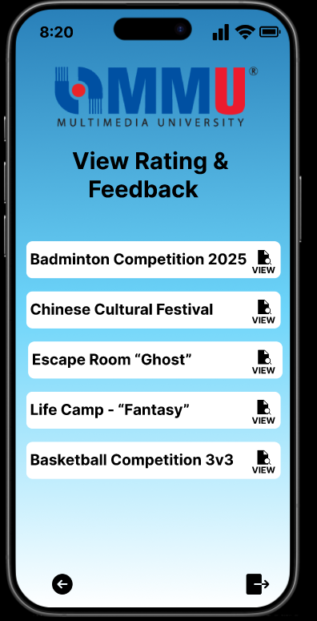
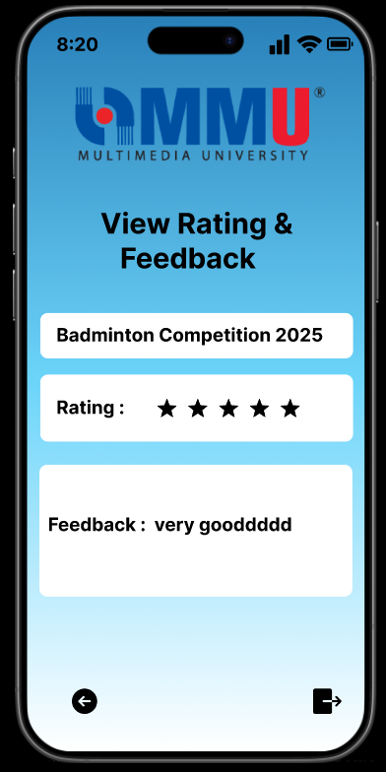
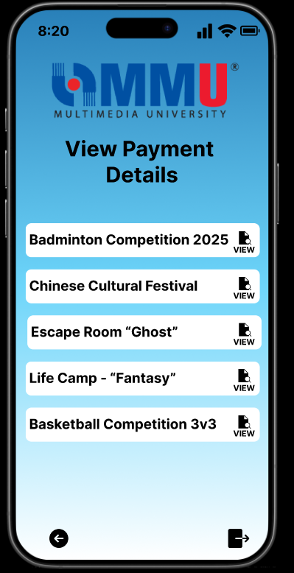
Prototyping
Event Rating Page (Admin)
View Event Payment Page (Admin)

Slide 26
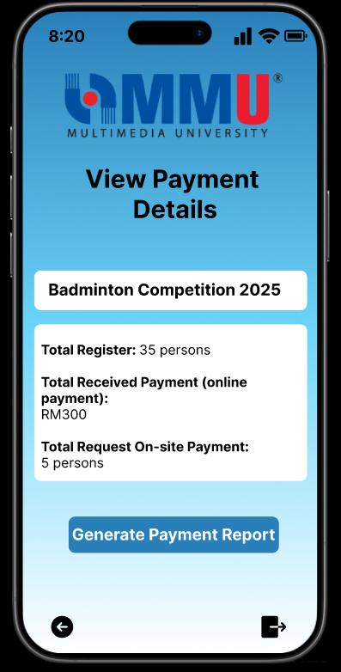
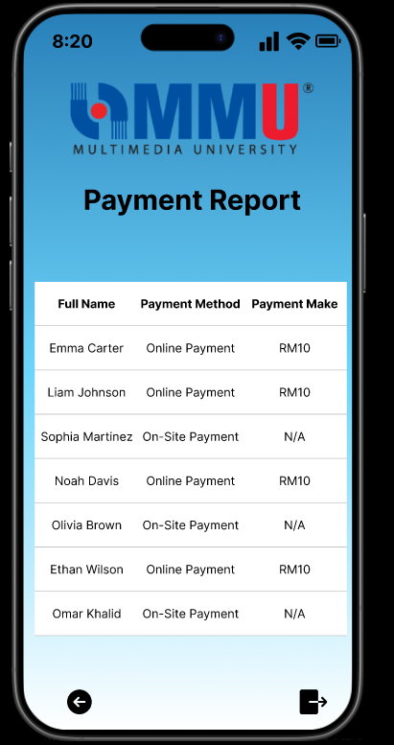
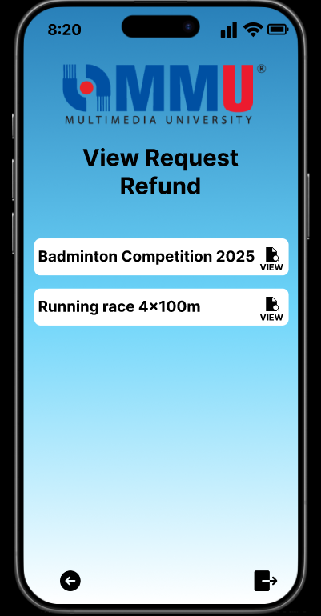
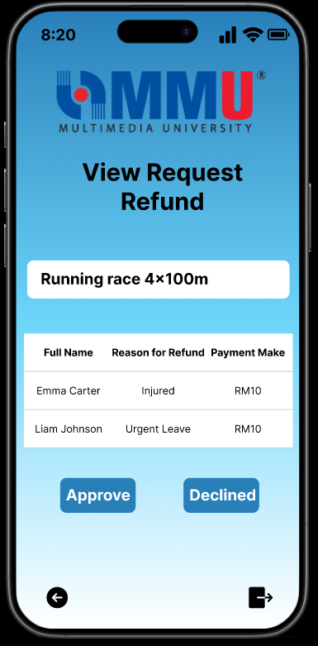
Prototyping
View Payment Details Page (Admin)
View Event Request Refund Page (Admin)

Slide 27
Questionnaire

Slide 28
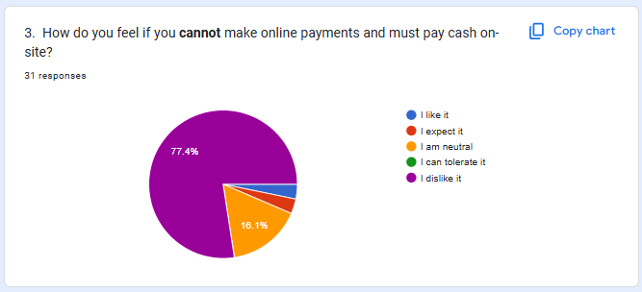
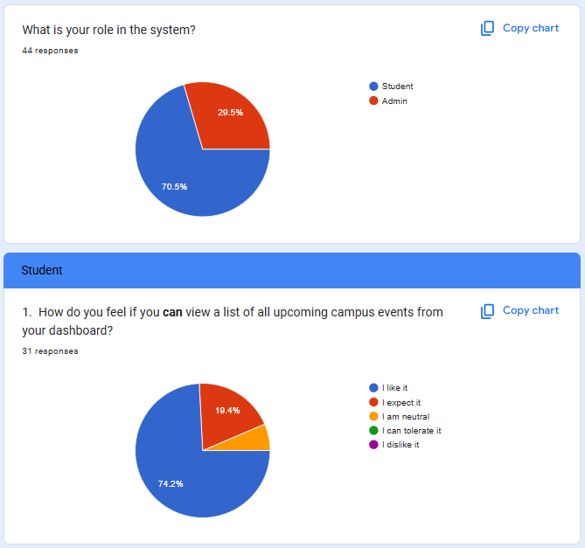
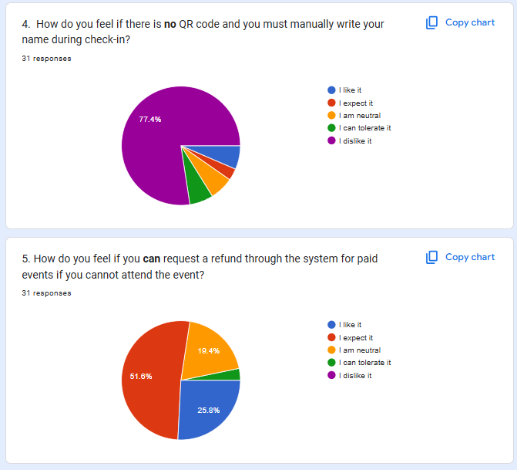
Questionnaire(Student)

Slide 29
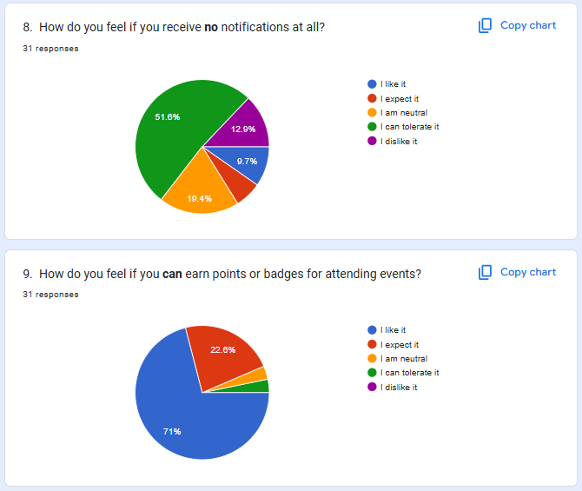
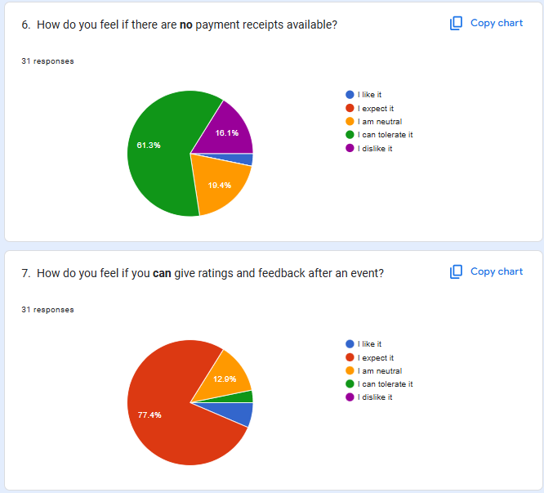
Questionnaire(Student)

Slide 30
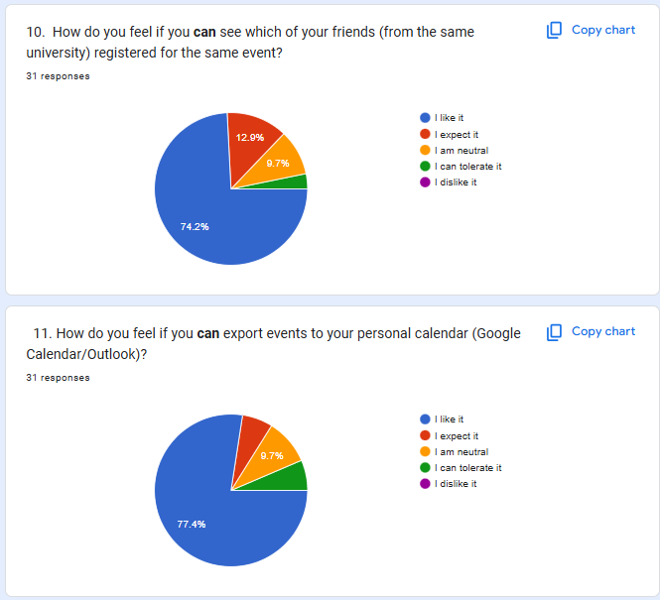
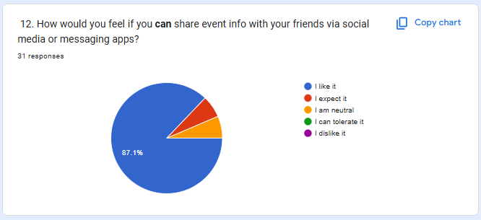
Questionnaire(Student)

Slide 31
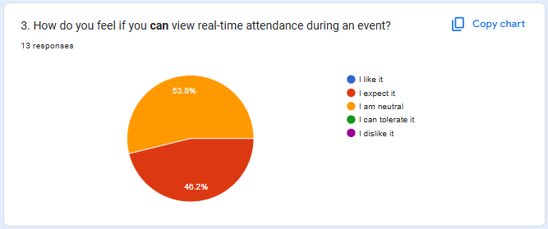
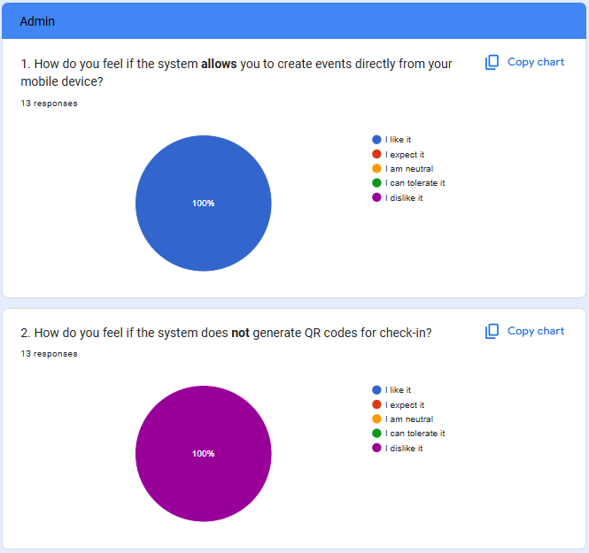

Questionnaire(Admin)

Slide 32


Questionnaire(Admin)

Slide 33
Final Requirement Elicited

Slide 34
User/Student Prototype

Slide 35
Login & View Events
Features Prototyped:
Secure login using university credentials.
View upcoming and participated events.
Filters for easy browsing.
Design Goals:
Simplicity and speed of access.
Familiar mobile UI patterns.

Slide 36
Event Registration & Notifications
Features Prototyped:
Secure login using university credentials.
View upcoming and participated events.
Filters for easy browsing.
Design Goals:
Simplicity and speed of access.
Familiar mobile UI patterns.

Slide 37
Payment (Online & On-site)
Features Prototyped:
Two modes: FPX, TNG (Online) & Manual (On-site).
Upload receipt for TNG payments.
Success/failure messaging.
Design Goals:
Ensure trust in payment flow.
Display clear payment feedback.

Slide 38
Feedback & Rating
Features Prototyped:
5-star rating + feedback textbox.
Submit confirmation.
Visibility of success message.
Design Goals:
Encourage honest, quick responses.
Maintain post-event engagement.

Slide 39
Admin Prototype

Slide 40
Login & Dashboard
Features Prototyped:
Secure admin login.
Dashboard access to modules (event mgmt, refund, reports).
Design Goals:
Keep functions grouped and quick to access.

Slide 41
Create & Manage Events
Features Prototyped:
Create event: venue, date, time, fee, category.
Edit/Delete existing events.
Design Goals:
Prevent data entry errors.
Show preview before confirming.

Slide 42
QR Code Generation & Attendance Tracking
Features Prototyped:
Generate QR for events.
Live tracking: present, absent, late stats.
Attendance pie chart.
Design Goals:
Instant visual feedback.
Easy access during live events.

Slide 43
Refund Handling & Reports
Features Prototyped:
View refund requests with "Approve/Decline."
View payment reports.
Export report option.
Design Goals:
Reduce admin decision time.
Make financial reporting seamless.

Slide 44
User Feedback & Iteration
Stakeholder feedback collected during testing.
Adjusted layout based on:
Too many fields on registration.
Confusing refund process.
Final designs improved:
Navigation flow.
Button placements.
Mobile accessibility.

Slide 45
References

Slide 46
References
IEEE Std 830-1998 – Recommended Practice for Software Requirements Specifications
CSE6224 Project Guidelines – Universiti Putra Malaysia
Eventbrite (https://www.eventbrite.com) – Used as a benchmark for event registration and check-in UX
Touch ‘n Go eWallet & FPX Payment Gateway Documentation – API and security references
Google Forms – Used for stakeholder questionnaire
Personal Data Protection Act (PDPA) – Compliance for handling student information
ISO/IEC 27001 – Information Security Management standards
Stakeholder Interviews & User Feedback (via Google Forms, May 2025)

Slide 47
Verification

Slide 48
Verification Area
1. Availability:
Uptime monitoring during active events
Real-time data sync test (Firebase)
2. Security:
HTTPS inspection
OAuth login & role-based access control
Performance:
Login and check-in tested under load
QR code generation ≤1 sec

Slide 49
Verification Area
3. Usability:
User walkthroughs with prototypes
Action flow: ≤3 steps per key task
4. Scalability:
Load simulation for 5,000+ users
Bulk report generation tests
Accuracy:
Cross-checks on check-in, payment, refund data

Slide 50
Conclusion
What We Achieved？
Seamless event lifecycle from registration to feedback.
Real-time attendance and secure payments.
Enhanced user experience through prototyping and feedback.
Benefits to the University
Reduces administrative workload.
Improves student engagement and satisfaction.
Supports data-driven event management.

Slide 51
THANK YOU

